Slide 1
DataMining
Data mining is a process of extracting useful information or patterns from large datasets. It involves analyzing and discovering relationships, patterns, anomalies, and trends within the data. This process is commonly used in various fields such as business, finance, healthcare, marketing, and more

Slide 2
Steps involved in Data Mining or Data mining Funtionalities
• Business Understanding,
• Data Understanding,
• Data Preparation,
• Data Modeling and data mining techniques,
• Evaluation and
• Deployment

Slide 3
Techniques used in Data Mining
Cluster Analysis: It enables to identification a given user group according to common features in a database. These features could include age, location, education level . Ex: K-Means Clustering, Hierarchical Clustering
Anomaly Detection: It is used to determine when something is noticeably different from the regular pattern. It is used to eliminate any database inconsistencies or anomalies at the source. Ex: Z-Score or Standard Score, K-Nearest Neighbors
Regression Analysis This technique is used to make predictions based on relationships within the data set. For example, one can predict the stock rate of a particular product by analyzing the past rate and by taking into account the different factors that determine the stock rate. Ex: Linear Regression, Decision tree etc.,
Classification This deals with the things which have labels on it. Note in cluster detection, the things did not have a label in it and by using data mining we had to label and form into clusters, but in classification, there is information existing that can be easily classified using an algorithm. Ex: Logistic regression, Decision tree, SVM etc.,

Slide 4
Data mining Algorithms: K-Means
K-Means is one of the most widely used clustering algorithms. It partitions the data into 'K' clusters, where 'K' is a user-defined parameter.
Process: It starts by randomly selecting 'K' centroids (initial cluster centers), assigns each data point to the nearest centroid, recalculates the centroids based on the assigned data points, and repeats this process until convergence.
Advantages: Fast and efficient for large datasets, easy to implement.
Disadvantages: Sensitive to the initial placement of centroids, may converge to a local minimum.

Slide 5
Naive Bayes Algorithm
The Naive Bayes algorithm is a probabilistic machine learning algorithm that is used for classification tasks. It's based on Bayes' theorem and the assumption of independence between features, which is why it's called "naive.“
Bayes' theorem is a fundamental principle in probability theory that relates conditional probabilities. For a classification problem, it's used to calculate the probability of a certain class given the features of a data point:
P(C|x) = (P(x|C) * P(C)) / P(x)
Where:
P(C|x) is the probability of class C given the features x.
P(x|C) is the probability of observing the features x given class C.
P(C) is the prior probability of class C.
P(x) is the probability of observing the features x.

Slide 6
Linear Regression
Linear regression is considered one of the foundational techniques in data mining and machine learning. It is a statistical modeling approach used for analyzing the relationship between a dependent variable (target variable) and one or more independent variables (predictor variables).
It is a statistical approach for modeling the relationship between a dependent variable and a given set of independent variables.
The aim of linear regression is to find the regression coefficients that produce the best-fitted line or output.
y = ax + b

Slide 7
Decision tree
A decision tree is a hierarchical structure where each node represents a feature, each branch represents a decision rule, and each leaf node represents an outcome or prediction.
Process:
Feature Selection: Choose the best feature to split the data.
Splitting: Divide the data into subsets based on the selected feature's values.
Recursion: Repeat the process recursively for each subset until a stopping criterion is met.

Slide 8
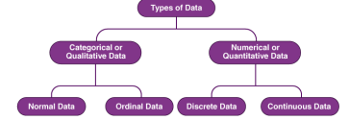
Types of data

Slide 9
Integrating Data Mining with Data Warehouse
A data warehouse provides a structured, centralized repository for storing and managing large volumes of data, while data mining techniques help extract valuable insights and patterns from this data
No Coupling − In this scheme, the data mining system does not utilize any of the database or data warehouse functions. It fetches the data from a particular source and processes that data using some data mining algorithms. The data mining result is stored in another file.
• Loose Coupling − In this scheme, the data mining system may use some of the functions of the database and data warehouse system. It fetches the data from the data respiratory managed by these systems and performs data mining on that data. It then stores the mining result either in a file or in a designated place in a database or in a data warehouse.
• Semi−tight Coupling − In this scheme, the data mining system is linked with a database or a data warehouse system and in addition to that, efficient implementations of a few data mining primitives can be provided in the database.
• Tight coupling − In this coupling scheme, the data mining system is smoothly integrated into the database or data warehouse system. The data mining subsystem is treated as one functional component of an information system

Slide 10
Data mining task primitives
Data mining task primitives refer to the fundamental operations or tasks that are commonly performed in the process of extracting useful information from data. These primitives serve as building blocks for more complex data mining operations. There are typically four main data mining task primitives:
Descriptive Data Mining:
Concept Description: This task involves summarizing and characterizing the general properties or characteristics of a dataset. It aims to provide an overview of the data's distribution, trends, and key features. For example, generating summary statistics or visualizations.
Data Visualization: This task focuses on representing data graphically to facilitate understanding and interpretation. It helps in identifying patterns, trends, and outliers in the data.
Predictive Data Mining:
Classification: Classification involves assigning predefined categories or labels to new, unseen data points based on the patterns learned from a labeled training dataset. It is used for tasks like spam filtering, sentiment analysis, and medical diagnosis.
Regression: Regression predicts a numerical value or a continuous variable based on the relationships learned from the training data. It is used for tasks like sales forecasting, price prediction, and demand estimation.

Slide 11
Clustering:
Clustering or Cluster Analysis: Clustering groups similar data points together based on their features or characteristics. It is an unsupervised learning task, meaning that the algorithm does not use predefined labels. Clustering is used for tasks like customer segmentation, anomaly detection, and image segmentation.
Association Rule Discovery:
Association Rules: This task involves discovering interesting relationships or associations between different attributes or items in a dataset. It is commonly used in market basket analysis, where the goal is to find patterns in consumer behavior, such as which items are frequently purchased together.

Slide 12
The data mining primitives specify the following,
1. Set of task-relevant data to be mined. (Data)
2. Kind of knowledge to be mined. (Knowledge or problem)
3. Background knowledge to be used in the discovery process. (Basic needs)
4. Techniques and Interestingness measures and thresholds for pattern evaluation. (Metric)
5. Representation for visualizing the discovered patterns. (Representation)

Slide 13
Data Preprocessing
Data preprocessing is the process of transforming raw data into an understandable format. It is also an important step in data mining as we cannot work with raw data. The quality of the data should be checked before applying machine learning or data mining algorithms. The data preprocessing phase is perhaps the most crucial one in the data mining process.

Slide 14
Steps Involved in Data Preprocessing:
Data Cleaning: The data can have many irrelevant and missing parts. To handle this part, data cleaning is done. It involves handling of missing data, noisy data etc.
a) Missing Data: This situation arises when some data is missing in the data. It can be handled in various ways. Some of them are:
1. Ignore the tuples: This approach is suitable only when the dataset we have is quite large and multiple values are missing within a tuple.
2. Fill the Missing values: There are various ways to do this task. You can choose to fill the missing values manually, by attribute mean or the most probable value.
b) Noisy Data: Noisy data is a meaningless data that can’t be interpreted by machines.It can be generated due to faulty data collection, data entry errors etc. It can be handled in following ways :
• Binning Method: This method works on sorted data in order to smooth it. The whole data is divided into segments of equal size and then various methods are performed to complete the task. Each segmented is handled separately. One can replace all data in a segment by its mean or boundary values can be used to complete the task.
Regression: Here data can be made smooth by fitting it to a regression function.The regression used may be linear (having one independent variable) or multiple (having multiple independent variables).
• Clustering: This approach groups the similar data in a cluster. The outliers may be undetected, or it will fall outside the clusters.

Slide 15
Data Transformation
Data Transformation: This step is taken in order to transform the data in appropriate forms suitable for mining process. This involves following ways:
• Normalization: It is done in order to scale the data values in a specified range (-1.0 to 1.0 or 0.0 to 1.0)
• Attribute Selection: In this strategy, new attributes are constructed from the given set of attributes to help the mining process.
• Discretization: This is done to replace the raw values of numeric attribute by interval levels or conceptual levels.
• Concept Hierarchy Generation: Here attributes are converted from lower level to higher level in hierarchy. For Example-The attribute “city” can be converted to “country”

Slide 16
Data Reduction
Data Reduction: Since data mining is a technique that is used to handle huge amount of data. While working with huge volume of data, analysis became harder in such cases. In order to get rid of this, we uses data reduction technique. It aims to increase the storage efficiency and reduce data storage and analysis costs. The various steps to data reduction are:
• Data Cube Aggregation: Aggregation operation is applied to data for the construction of the data cube.
• Attribute Subset Selection: The highly relevant attributes should be used, rest all can be discarded.
• Dimensionality Reduction: This reduce the size of data by encoding mechanisms. It can be lossy or lossless. If after reconstruction from compressed data, original data can be retrieved, such reduction are called lossless reduction else it is called lossy reduction. The two effective methods of dimensionality reduction are: Wavelet transforms and PCA (Principal Component Analysis).

Slide 17
Data integration
Data integration: The process of combining multiple sources into a single dataset. The Data integration process is one of the main components in data management. There are some problems to be considered during data integration.
• Schema integration: Integrates metadata (a set of data that describes other data) from different sources.
• Entity identification problem: Identifying entities from multiple databases. For example, the system should know Employee of one database and worker of another database belongs to the same entity.
• Detecting and resolving data value concepts: The data taken from different databases while merging may differ. Like the attribute values from one database may differ from another database. For example, the date format may differ like “MM/DD/YYYY” or “DD/MM/YYYY”.

Slide 18
Association rule mining and classification
Association rule mining is a data mining technique used to discover interesting relationships, patterns, or associations between different attributes or items in a dataset. It is particularly useful in market basket analysis, where the goal is to find patterns in consumer behavior, such as which items are frequently purchased together.
For example, with the weather data, we can form this rule:
If windy = false and play = no then outlook = sunny and humidity = high
With the exam database, we can form the association rules
If prod_placed_together = “bread and butter” then sales=high
If prod_placed_together =“bread and pencil” then sales=low

Slide 19
Classification
Classification is a data mining technique used to predict the categorical class labels of new, unseen data points based on the patterns learned from a labeled training dataset.
Reading the Input and spilt the Inputs
Training Phase:
Use a labeled training dataset to build a classification model. The model learns to map input features to their corresponding class labels.
Model Evaluation:
Assess the performance of the classification model using metrics like accuracy, precision, recall, and F1-score on a validation set or through cross-validation.
Testing Phase:
Apply the trained model to new, unseen data points to predict their class labels.
Model Fine-Tuning : Compare all models results
Optionally, fine-tune the model based on feedback from the testing phase or adjust hyperparameters to improve performance.

Slide 20
Frequent pattern Mining
Frequent pattern mining is a data mining technique used to discover sets of items or attributes that frequently occur together in a dataset. These sets are known as frequent itemsets, and they represent patterns of co-occurrence or association in the data.

Slide 21
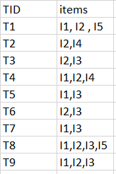
Consider the following dataset and we will find frequent itemsets and generate association rules for them using apriori algorithm. When k=3 and min_support=2

Slide 22
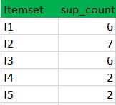
Step-1: K=1

Slide 23
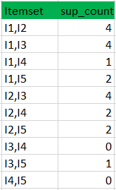
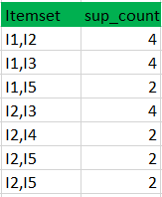
Step-2: K=2

Slide 24

Step 3: K=3
Itemset | Sup+Count
I1 I2 I3 | 2
I1 I2 I4 | 1
I1 I2 I5 | 2

Slide 25
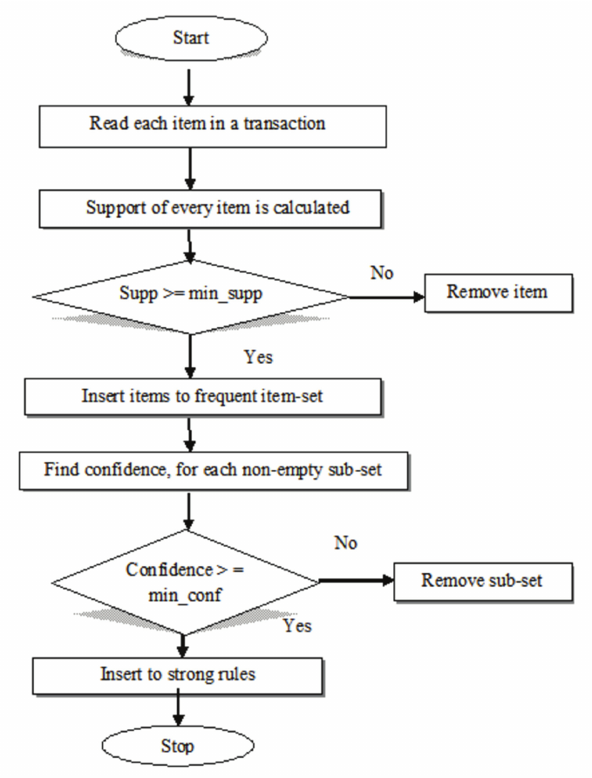

Slide 26
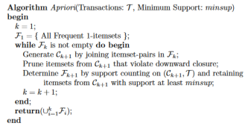

Slide 27
Multilevel association rules
Mining multilevel association rules involves discovering patterns in data that involve multiple levels of abstraction or granularity. This can be particularly useful when you have data organized in a hierarchical or structured manner, and you want to find associations at different levels of detail.
One common approach for mining multilevel association rules is to use techniques like Generalized Association Rules (GAR) or Multilevel Association Rules (MAR). These techniques extend traditional association rule mining to handle hierarchically organized data.

Slide 28
General outline of mining multilevel association rules:
Data Preprocessing: Organize your data in a hierarchical or structured format. This could be represented as a tree, graph, or some other form of hierarchy.
Define Levels of Abstraction: Identify the different levels of detail or abstraction in your data. For example, if you're analyzing sales data, different levels could be product categories, subcategories, and individual products.
Generate Association Rules: Apply a multilevel association rule mining algorithm to your data. This algorithm should be designed to handle hierarchical relationships.
Extract Multilevel Rules: The output of the mining process will be a set of association rules that span multiple levels of abstraction. These rules will provide insights into how items or attributes at different levels relate to each other.

Slide 29
Example
Suppose we have the following transaction data:
Transaction 1: {Bread, Milk, Lotion}
Transaction 2: {Bread, Eggs}
Transaction 3: {Lotion, Milk, Diapers}
Transaction 4: {Bread, Milk, Diapers}
Transaction 5: {Eggs, Diapers}
And we have the following hierarchy:
Category: {Food, Non-Food}
Subcategories:
- Food: {Bakery}
- Non-Food: {Baby Care}

Slide 30
Multilevel association rule for each items
One example of a multilevel association rule for Bread could be:
{Food, Bakery} => {Bread}
Another example of a multilevel association rule for Diaper could be could be:
{Non-Food, Baby Care} => {Diapers}

Slide 31
Multi dimensional Association rules
Multidimensional association rules refer to patterns or relationships discovered in multi-dimensional datasets, where the data is organized along multiple attributes or dimensions. These rules extend the concept of association rules, which are typically found in transactional data, to scenarios where there are multiple characteristics or factors at play.

Slide 32
Example 1
Suppose we have sales data in a retail store organized along given dimensions:
Product Categories: {Electronics, Clothing, Home Appliances}
Customer Segments: {Regular, VIP}
Then the association rule can formed as
{Product Category: Electronics, Customer Segment: VIP} => {Revenue: High}

Slide 33
Example 2
Suppose we have sales data organized along given dimensions:
Age: {20-29, 30-39, 40-50}
Occupation: {Student, Electrician, Plumebr}
Then the association rule can formed as
age(X, “20...29”) ∧ occupation(X, “student”)⇒buys(X, “laptop”).

Slide 34
General outline of mining multi-dimensional association rules:
Data Preprocessing: Organize your data in a structured format with multiple attributes or dimensions.
Define Dimensions and Measures: Identify the different dimensions in your data. For example, in sales data, dimensions could be products, customers, time, etc. Measures are the numerical values associated with these dimensions, like quantity sold or revenue.
Build Data Cube or represent the data: Construct a data cube by aggregating and summarizing the data along different combinations of dimensions. This forms a multi-dimensional view of the data.
Generate Association Rules: Apply a multi-dimensional association rule mining algorithm to your data cube. This algorithm should be designed to handle multiple dimensions.
Extract Multi-Dimensional Rules: The output of the mining process will be a set of association rules that span multiple dimensions. These rules will provide insights into how different combinations of attributes relate to each other.

Slide 35
Decision Tree Classification

Slide 36
Decision Tree
A Decision Tree is a simple representation for classifying examples.
It is a Supervised Machine Learning where the data is continuously split according to a certain parameter.

Slide 37
Decision Tree consists of :
Nodes : Test for the value of a certain attribute.
Edges/ Branch : Correspond to the outcome of a test and connect to the next node or leaf.
Leaf nodes : Terminal nodes that predict the outcome (represent class labels or class distribution).

Slide 38
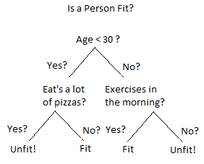

Slide 39
Types of Decision Tree
Classification Trees
Regression Trees

Slide 40
Classification Trees(Yes/No Types)
The decision variable is Categorical/ discrete.
Tree is built through a process known as binary recursive partitioning.
This is an iterative process of splitting the data into partitions, and then splitting it up further on each of the branches.

Slide 41
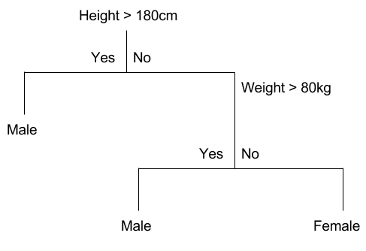
Classification Tree

Slide 42
Regression trees (Continuous data types)
Decision trees where the target variable can take continuous values (typically real numbers) are called regression trees.
Example:
The price of a house, or
A patient’s length of stay in a hospital

Slide 43
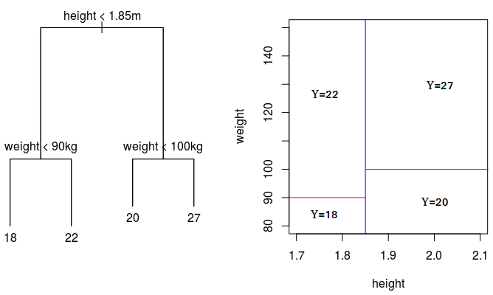
Regression Tree

Slide 44
Example code for decision tree
from sklearn.tree import DecisionTreeClassifier
# Define the dataset
age = [20, 32, 42, 15]
eat_pizza = [1, 0, 0, 1]
exercise = [1, 1, 0, 1]
health = [1, 1, 0, 1]
# Combine features into a 2D array
X = list(zip(age, eat_pizza, exercise))
# Define the target variable (health)
y = health
# Create a Decision Tree Classifier
clf = DecisionTreeClassifier()

Slide 45
# Train the classifier
clf = clf.fit(X, y)
# Predict health for a new instance
new_instance = [[25, 1, 1]] # age=25, eat_pizza=1, excercise=1
predicted_health = clf.predict(new_instance)
print(f"Predicted health: {predicted_health[0]}")

Slide 46
Naive Bayes

Slide 47
Introduction
It is based on Bayes' theorem and the assumption of independence among features. It calculates the probability of a class given the input features.
It is a classification technique based on Bayes Theorem with an assumption of independence among predictors.
In simple terms, a Naive Bayes classifier assumes that the presence of a particular feature in a class is unrelated to the presence of any other feature.
For example, a loan applicant is desirable or not depending on his/her income, previous loan and transaction history, age, and location.
Even if these features are interdependent, these features are still considered independently. This assumption simplifies computation, and that's why it is considered as naive.

Slide 48

Bayes Theorem
P(X/Y) is a conditional probability that describes the occurrence of event X is given that Y is true.
P(Y/X) is a conditional probability that describes the occurrence of event Y is given that X is true.
P(X) and P(Y) are the probabilities of observing X and Y independently of each other. This is known as the marginal probability.

Slide 49
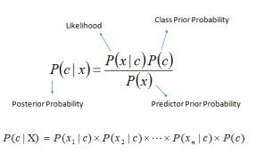
Bayes Theorem

Slide 50
Bayes Theorem
P(c|x) is the posterior probability of class (c, target) given predictor (x, attributes).
P(c) is the prior probability of class.
P(x|c) is the likelihood which is the probability of predictor given class.
P(x) is the prior probability of predictor.

Slide 51
Example: Classifying the healthy status using Naïve bayes classification
from sklearn.naive_bayes import GaussianNB
# Define the dataset
age = [20, 32, 42, 15]
eat_pizza = [1, 0, 0, 1]
exercise = [1, 1, 0, 1]
health = [1, 1, 0, 1]
# Combine features into a 2D array
X = list(zip(age, eat_pizza, exercise))
# Define the target variable (health)
y = health
# Create a Gaussian Naive Bayes Classifier
clf = GaussianNB()

Slide 52
# Train the classifier
clf = clf.fit(X, y)
# Predict health for a new instance
new_instance = [[25, 1, 1]] # age=25, eat_pizza=1, excercise=1
predicted_health = clf.predict(new_instance)
print(f"Predicted health: {predicted_health[0]}")

Slide 53
Support Vector Machine

Slide 54
Support Vector Machines
Support Vector Machines is considered to be a classification approach, it but can be employed in both types of classification and regression problems.
It can easily handle multiple continuous and categorical variables.
SVM constructs a hyper plane in multidimensional space to separate different classes.
SVM generates optimal hyper plane in an iterative manner, which is used to minimize an error.
The core idea of SVM is to find a maximum marginal hyper plane(MMH) that best divides the dataset into classes.

Slide 55
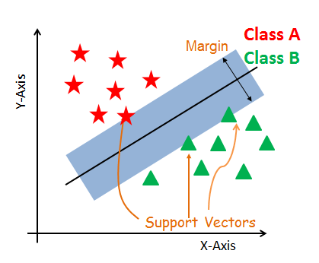
Support Vector Machines

Slide 56
How does SVM work?
The main objective is to segregate the given dataset in the best possible way.
The distance between the either nearest points is known as the margin.
The objective is to select a hyperplane with the maximum possible margin between support vectors in the given dataset.
SVM searches for the maximum marginal hyperplane in the following steps:

Slide 57
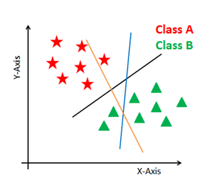
How does SVM work?
Generate hyper planes which segregates the classes in the best way. Below figure showing three hyper planes black, blue and orange. Here, the blue and orange have higher classification error, but the black is separating the two classes correctly.

Slide 58
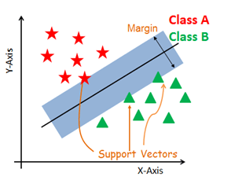
How does SVM work?
2. Select the right hyper plane with the maximum segregation from the either nearest data points as shown in below figure.

Slide 59
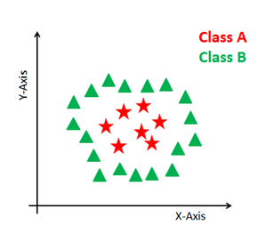
Dealing with non-linear and inseparable planes
Some problems can’t be solved using linear hyper plane.

Slide 60
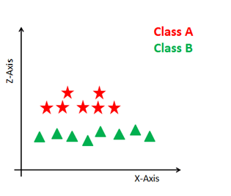
Dealing with non-linear and inseparable planes
In such situation, SVM uses a kernel trick to transform the input space to a higher dimensional space.
The data points are plotted on the x-axis and z-axis.

Slide 61
SVM Kernels
The SVM algorithm is implemented in practice using a kernel.
A kernel transforms an input data space into the required form.
SVM uses a technique called the kernel trick.
Here, the kernel takes a low-dimensional input space and transforms it into a higher dimensional space.
In other words, you can say that it converts nonseparable problem to separable problems by adding more dimension to it.
It is most useful in non-linear separation problem.
Kernel trick helps you to build a more accurate classifier.

Slide 62
SVM Kernels
Linear Kernel
Polynomial Kernel(can distinguish curved or non linear input space)
Radial Basis Function Kernel(map input space to infinite dimension space)

Slide 63
Python Code
from sklearn.svm import SVC
from sklearn.metrics import accuracy_score
clf = SVC(kernel='linear')
clf.fit(x_train,y_train)
y_pred = clf.predict(x_test)
print(accuracy_score(y_test,y_pred))

Slide 64
Clustering
Cluster: A collection of data objects
similar (or related) to one another within the same group
dissimilar (or unrelated) to the objects in other groups
Cluster analysis (or clustering, data segmentation, …)
Finding similarities between data according to the characteristics found in the data and grouping similar data objects into clusters
Unsupervised learning: no predefined classes (i.e., learning by observations vs. learning by examples: supervised)
Typical applications
As a stand-alone tool to get insight into data distribution
As a preprocessing step for other algorithms
64
Notes:
64

Slide 65
Quality: What Is Good Clustering?
A good clustering method will produce high quality clusters
high intra-class similarity: cohesive within clusters
low inter-class similarity: distinctive between clusters
The quality of a clustering method depends on
the similarity measure used by the method
its implementation, and
Its ability to discover some or all of the hidden patterns
65
Notes:
65

Slide 66
The K-Means Clustering Method
Given k, the k-means algorithm is implemented in four steps:
Partition objects into k nonempty subsets
Compute seed points as the centroids of the clusters of the current partitioning (the centroid is the center, i.e., mean point, of the cluster)
Assign each object to the cluster with the nearest seed point
Go back to Step 2, stop when the assignment does not change
66
Notes:
66

Slide 67
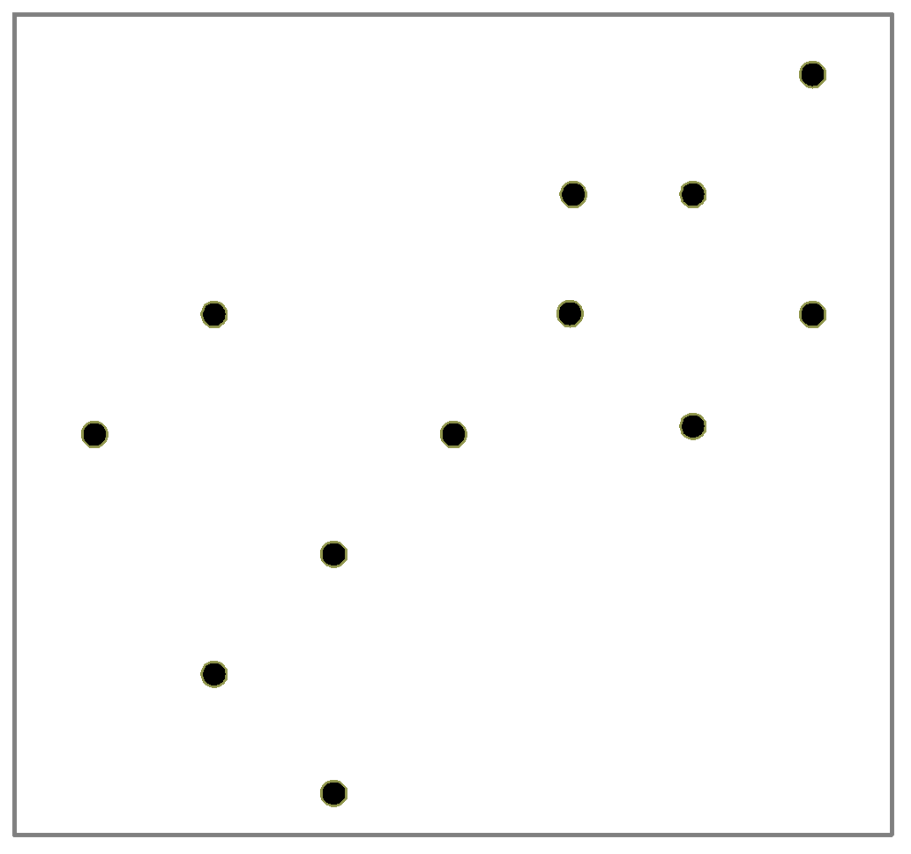
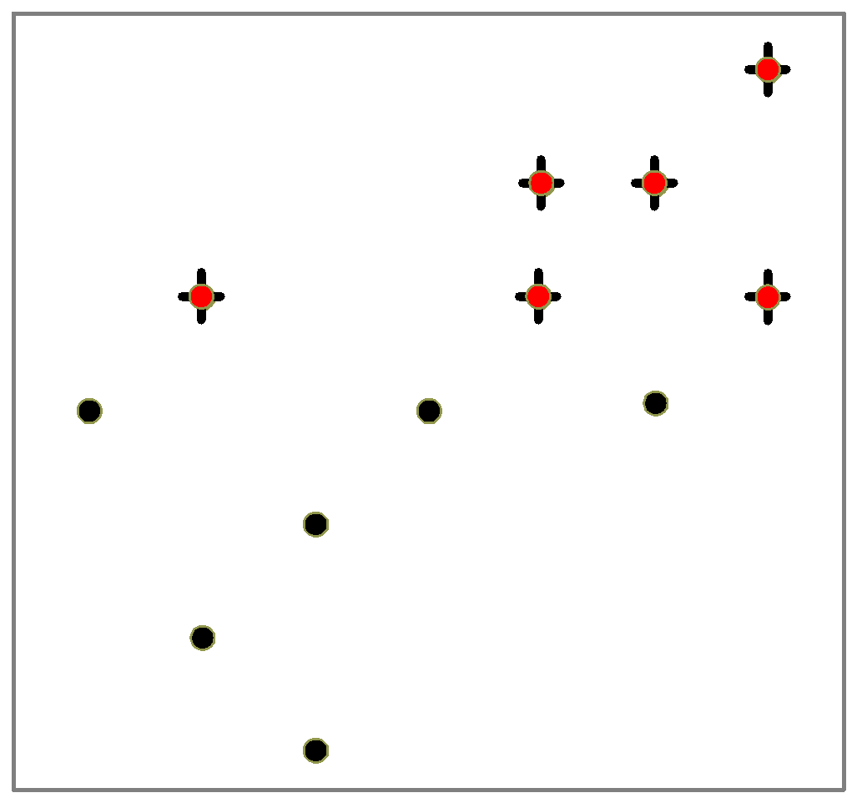
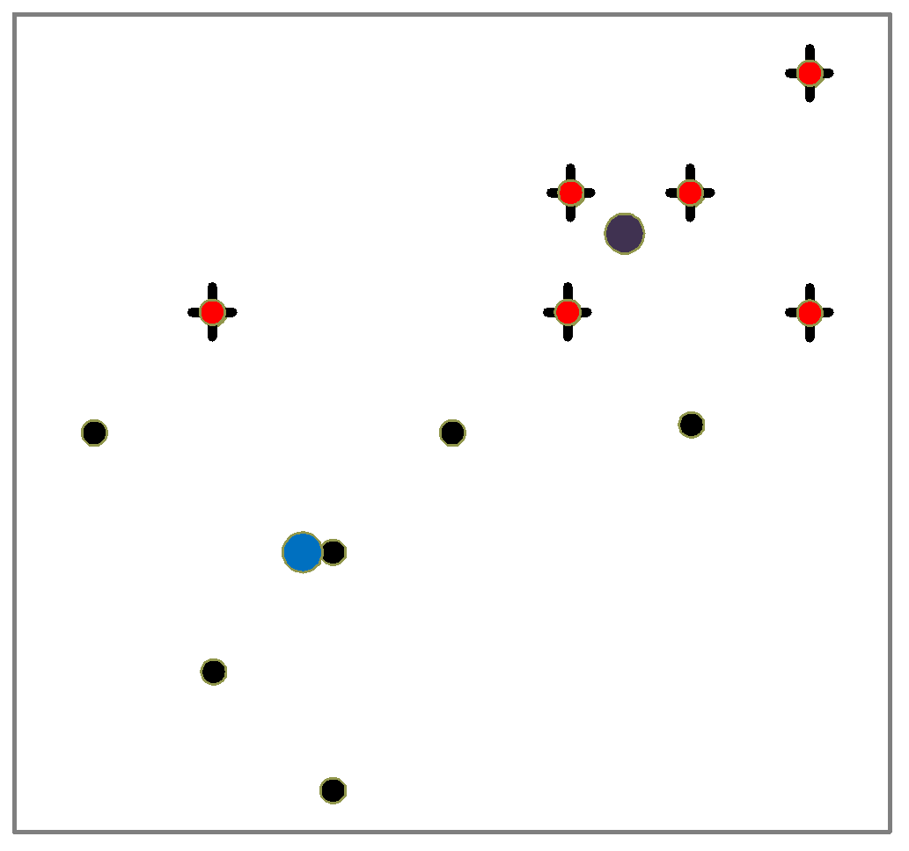
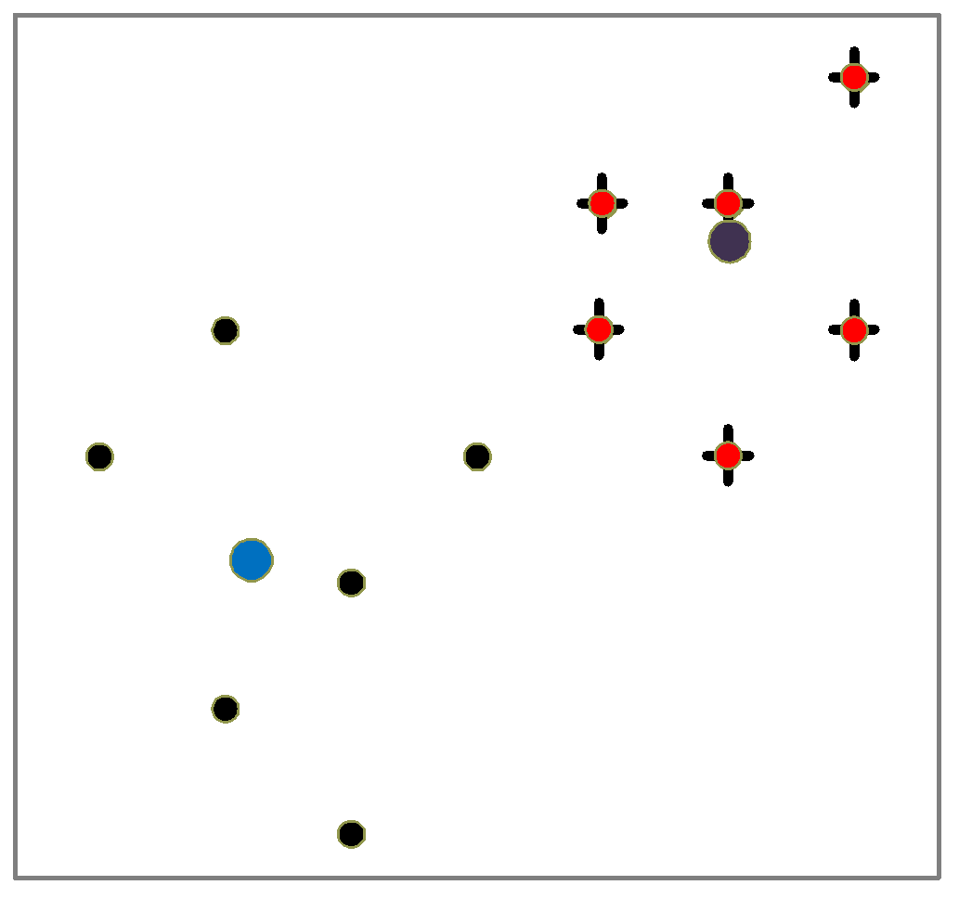
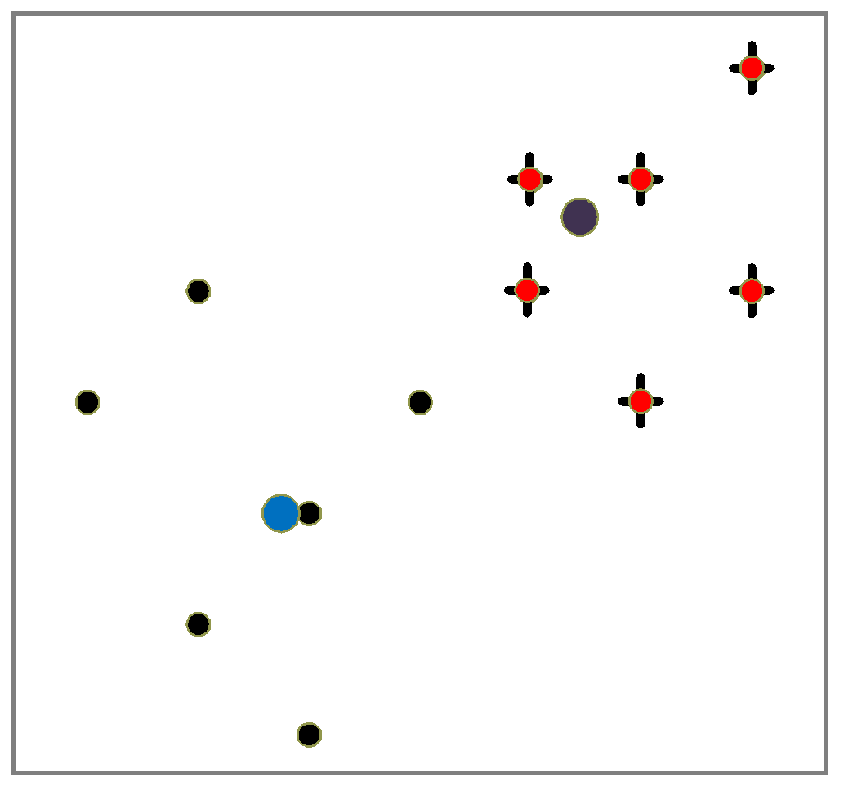
An Example of K-Means Clustering
K=2
Arbitrarily partition objects into k groups
Update the cluster centroids
The initial data set
Loop if needed
Reassign objects
Partition objects into k nonempty subsets
Repeat
Compute centroid (i.e., mean point) for each partition
Assign each object to the cluster of its nearest centroid
Until no change
Update the cluster centroids
67
Notes:
67

Slide 68
K-Means Example
import numpy as np
from sklearn.cluster import KMeans
# Generate some random data for demonstration
np.random.seed(0)
X = np.array([[1, 2], [1, 4], [1, 0],
[10, 2], [10, 4], [10, 0]])
# Define the number of clusters (K)
kmeans = KMeans(n_clusters=2, random_state=0)
# Fit the data to the KMeans algorithm
kmeans.fit(X)

Slide 69
Hierarchical Clustering
Process of grouping or splitting the data based on their featrues at each stage.
Step 0
Step 1
Step 2
Step 3
Step 4
agglomerative
(AGNES)
a
a b
b
a b c d e
c
c d e
d
d e
e
divisive
(DIANA)
Step 4
Step 3
Step 2
Step 1
Step 0
69
Notes:
69

Slide 70
Text Mining
Text mining, also known as text analytics, is the process of extracting meaningful information and insights from textual data. It involves various techniques and methods to analyze and understand unstructured text data. Text mining is widely used in fields like natural language processing, information retrieval, and data mining. Here are some key aspects of text mining:

Slide 71
Important process in text mining
Tokenization: Breaking down text into individual words or tokens.
Stopword Removal: Removing common words (e.g., "and", "the") that don't carry much information.
Stemming and Lemmatization: Reducing words to their base or root form (e.g., "running" -> "run").

Slide 72
Spatial data mining is a field of data mining that focuses on discovering interesting and useful patterns, relationships, and insights in datasets that have a spatial component. It combines techniques from data mining, geographic information systems (GIS), and statistics to extract knowledge from geospatial data.
Temporal data mining focuses on extracting patterns, trends, and insights from data that have a temporal or time-related component. This field is particularly important for analyzing time-series data, sequences, and events that occur over time.

Slide 73
SNO. | Spatial data mining | Temporal data mining
1. | It requires space. | It requires time.
2. | Spatial mining is the extraction of knowledge/spatial relationship and interesting measures that are not explicitly stored in spatial database. | Temporal mining is the extraction of knowledge about occurrence of an event whether they follow Cyclic , Random ,Seasonal variations etc.
3. | It deals with spatial (location , Geo referenced) data. | It deals with implicit or explicit Temporal content , from large quantities of data.
4. | It includes finding characteristic rules, discriminant rules, association rules and evaluation rules etc. | It aims at mining new and unknown knowledge, which takes into account the temporal aspects of data.
5. | Examples – Determining hotspots , Unusual locations. | Examples – An association rule which looks like – “Any Person who buys a car also buys steering lock”. By temporal aspect this rule would be – ” Any person who buys a car also buys a steering lock after that “.

Slide 74
Data Mining Applications
Customer Segmentation. This is one of the most widespread applications. Businesses use data mining to understand their customers. Cluster detection algorithms discover clusters of customers sharing the same characteristics.
Market Basket Analysis. This is a very useful application for retail. Link analysis algorithms uncover affinities between products that are bought together. Other businesses such as upscale auction houses use these algorithms to find customers to whom they can sell higher-value items.
Risk Management. Insurance companies and mortgage businesses use data mining to uncover risks associated with potential customers.
Fraud Detection. Credit card companies use data mining to discover abnormal spending patterns of customers. Such patterns can expose fraudulent use of the cards.
Delinquency Tracking. Loan companies use the technology to track customers who are likely to default on repayments.
Demand Prediction. Retail and other businesses use data mining to match demand and supply trends to forecast demand for specific products. (Refer GCR notes for more applictaions)

